Slide 1

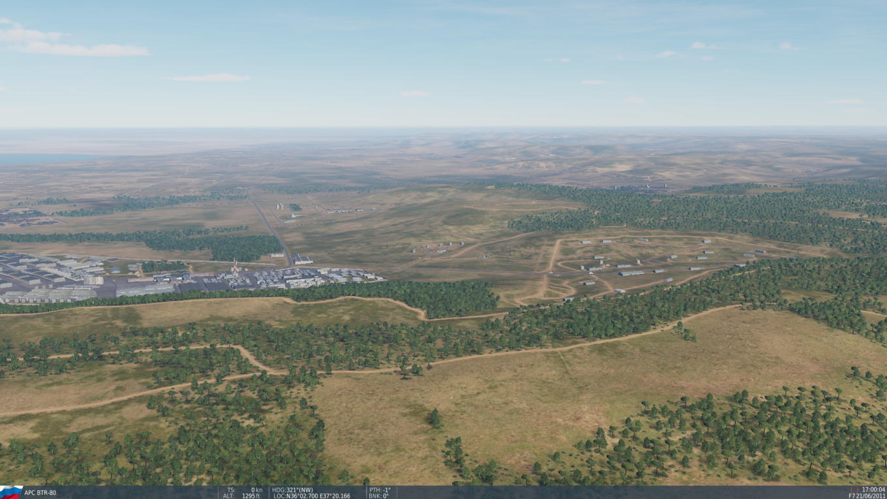
SYTGT135 Al Safira Chemical Weapons Depot
SYTGT135A-F
135
N
DESCRIPTION OF THE DESIRED POINTS OF IMPACT WITH WPN TYPE:
SYTGT135A – Storage 1
N36 02.781 E037 20.184 /1284ft / (500 Ibs bomb)
SYTGT135B – Storage 2
N36 02.719 E037 20.227 / 1302ft / (500 Ibs bomb)
SYTGT135C – Storage 3
N36 02.682 E037 20.219 / 1309ft / (500 Ibs bomb)
SYTGT135D– Storage 4
N36 02.654 E037 20.215 /1315ft / (500 Ibs bomb)
SYTGT135E – Storage 5
N N36 02.621 E037 20.204 / 1312ft / (500 Ibs bomb)
SYTGT135F – Administration building
N36 02.718 E037 20.141 / 1293ft / (500 Ibs bomb)
4
5
6
SYTGT135A-E – Storage tanks for chemical precursor for chemical weapons.
7
8

Slide 2

SYTGT135 Al Safira Chemical Weapons Depot
SYTGT135A-E
135
N
C
D
B
E
DESCRIPTION OF THE DESIRED POINTS OF IMPACT WITH WPN TYPE:
SYTGT135A – Storage 1
N36 02.781 E037 20.184 /1284ft / (500 Ibs bomb)
SYTGT135B – Storage 2
N36 02.719 E037 20.227 / 1302ft / (500 Ibs bomb)
SYTGT135C – Storage 3
N36 02.682 E037 20.219 / 1309ft / (500 Ibs bomb)
SYTGT135D– Storage 4
N36 02.654 E037 20.215 /1315ft / (500 Ibs bomb)
SYTGT135E – Storage 5
N N36 02.621 E037 20.204 / 1312ft / (500 Ibs bomb)
SYTGT135F – Administration building
N36 02.718 E037 20.141 / 1293ft / (500 Ibs bomb)
A
F
SYTGT135F
4
5
6
SYTGT135A-E – Storage tanks for chemical precursor for chemical weapons.
7
8

